Slide 1
CARDIO GOOD FITNESS

Slide 2
Content: Cardio good fitness is a retail store that deals in treadmills for a wide range of clients. They currently have three types of treadmills in stock TM195, TM498 and TM798. The retail store is looking for ways to boost sales this year. They intend to focus on all three types or focus on the brand that brings in more sales. Expectation : 1.Develop a customer profile (characteristics of a customer) of the different products 2.Perform univariate, bivariate and multivariate analyses 3.Generate a set of insights and recommendations that will help the company in targeting new customers

Slide 3
Business Problem Overview and Solution Approach
Core business idea:
Business is into the retailing of treadmills(TM195, TM498,TM798).
Problem to tackle:
Increase sales
Increase treadmill in stock
Target market
Make more profit on the type patronized by clients
Find out which brand is more efficient.

Slide 4

Data Overview
Variable | Value | Data type
Product | TM195,TM498,TM798 | categorical
Age | 18-50 years | numerical
Gender | Male/female | categorical
Education | 12-21 | numerical
Marital Status | Single/partnered | categorical
Usage | 2-7 | numerical
Fitness | 1-5 | numerical
Income | 30K-100K | numerical
Miles | 21-360 | numerical
Data is from customers of a treadmill product of a retail shop known as Cardio Good fitness.
Product, Gender and Marital status were changed from object to categorical.

Slide 5
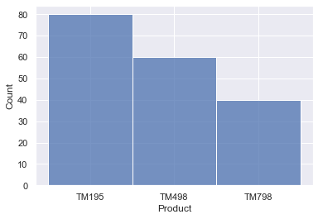
Exploratory data analysis PRoDUCT
The most count brand is TM195
TM798 has the least count.

Slide 6
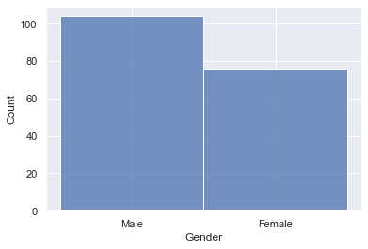
Gender variable
27% more males than females in the distribution

Slide 7
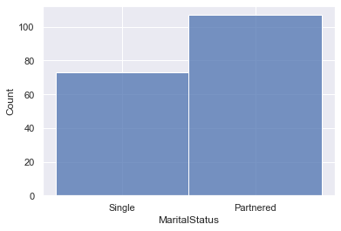
MARITAL STATUS VARIABLE
Partners are more than singles in the distribution

Slide 8
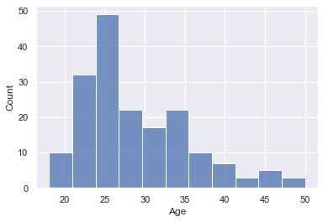
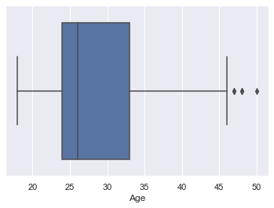
AGE VARIABLE
Age is skewed to the left
26 is the mean when box plot is used
Outliers present which affects the various percentiles.
25 is the mean age for this data.

Slide 9
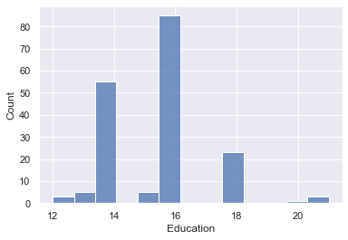
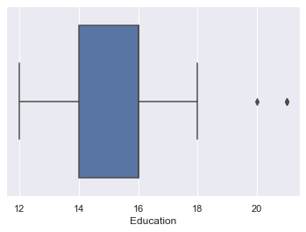
Education
Mean and median is equal
Few outliers are present to the right
25th and 75th percentiles are 12 and 18 respectively

Slide 10
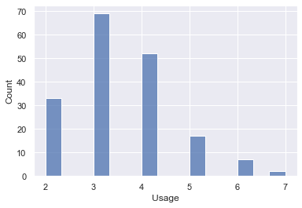

USAGE
Majority of clients use the product three times in a week and the lowest is seven times.
Zero skewed because mean equals median
Outliers present which affect mean and median
25th and 75th percentiles are 2 and 5 respectively.
The distribution is similar to education. It suggest possible correlation between the two variables.

Slide 11
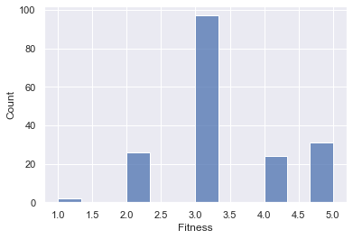
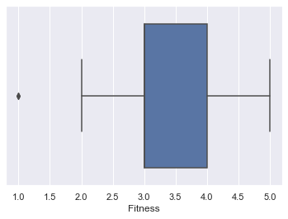
fitness
Most of the clients fitness level was at 3.
Zero skewed because mean equals median
Outlier present.

Slide 12
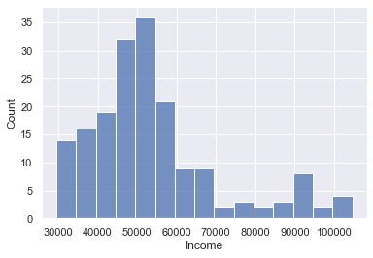
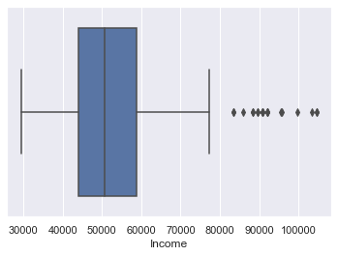
income
Negatively skewed
Outliers present at the right.

Slide 13
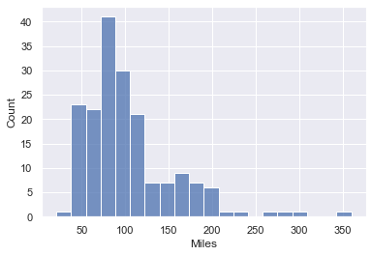
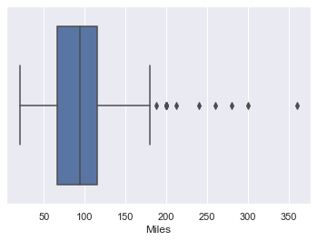
MILES
Mean miles run on the product is in 90.
Skewed to the left
Outliers present on the right.
Mean must be 90 miles.

Slide 14
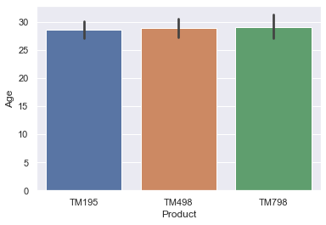
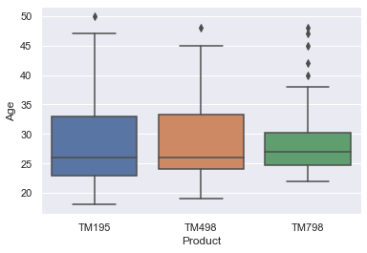
All the brands are almost in the same age bracket.
Outliers present
Mean is close across all brands.

Slide 15
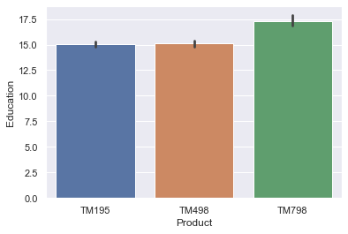
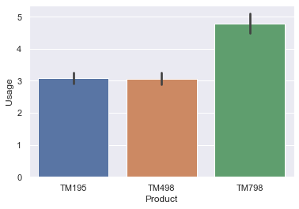
Education doesn't really have an impact on the type of product even though clients with higher education prefer TM798
Usage is higher in TM798 owners than the rest.
Level of usage for tm195 and tm498 is around 3.

Slide 16
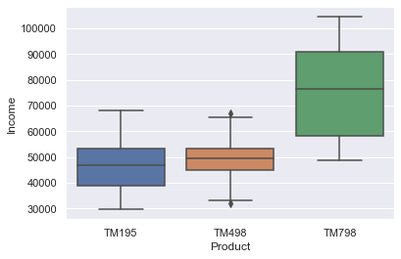
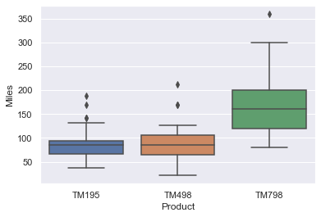
There are no outliers in TM195 and TM798 income
The mean for TM195 and TM498 is almost close but that of TM798 is around 78000.
There are outliers in all the product types which will have significant effect on the mean.
TM798 has more miles than other brands.

Slide 17

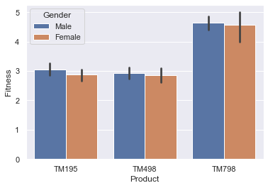
Users of TM798 have higher fitness level than TM195 and TM498.
Fitness level of males is slightly higher than females in all products.

Slide 18
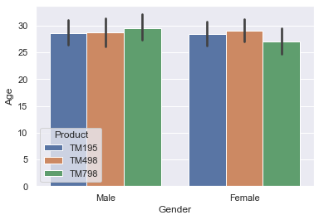
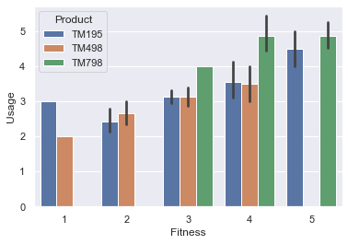
Age and gender dont have any significant effect on choice of product.
Frequent usage is matched up with high fitness TM195 and TM498 have lower usage.

Slide 19
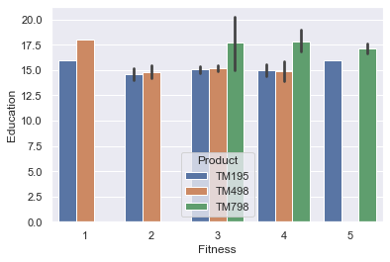
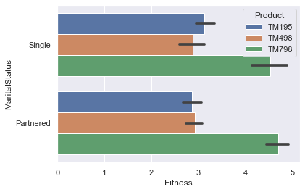
Clients with high education have high level of fitness.
Clients with high education prefer tm798
Both single and partnered preferred TM798

Slide 20
CORRELATION BETWEEN NUMERICAL VARIABLES
 | Age | Education | Usage | Fitness | Income | Miles
Age | 1.000000 | 0.280496 | 0.015064 | 0.061105 | 0.513414 | 0.036618
Education | 0.280496 | 1.000000 | 0.395155 | 0.410581 | 0.625827 | 0.307284
Usage | 0.015064 | 0.395155 | 1.000000 | 0.668606 | 0.519537 | 0.759130
Fitness | 0.061105 | 0.410581 | 0.668606 | 1.000000 | 0.535005 | 0.785702
Income | 0.513414 | 0.625827 | 0.519537 | 0.535005 | 1.000000 | 0.543473
Miles | 0.036618 | 0.307284 | 0.759130 | 0.785702 | 0.543473 | 1.000000

Slide 21
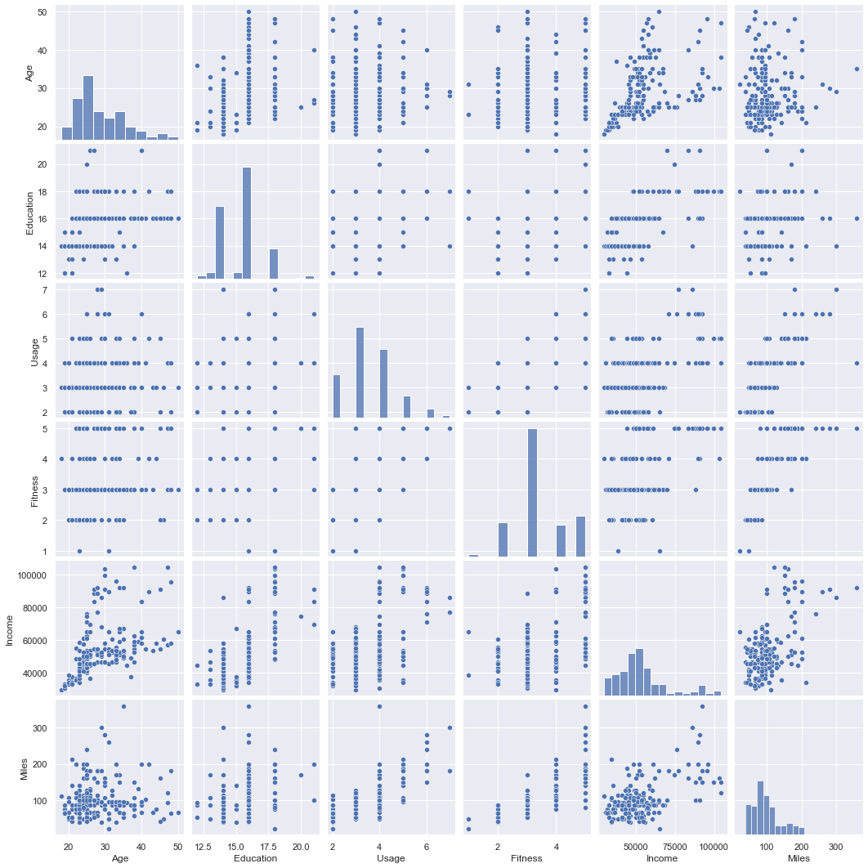
pAIRPLOT

Slide 22
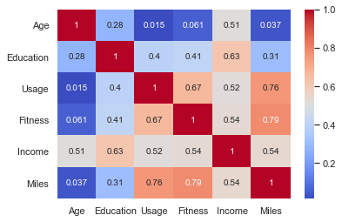
HEATMAP OF NUMERICAL VARIABLES
There is high correlation between miles and usage.
Fitness is also expected to have a high correlation with miles.
Positive correlation also exist between fitness and usage.
Fairly high correlation also exist between income and education.
No negative correlation exist in map above, although the lowest is usage and age.

Slide 23
Conclusion
Users of TM798 have the highest fitness
Users of TM798 have the highest usage
High fitness is as results of high usage of treadmill not necessarily the brand.
Clients who barely used the TM195 and TM498 were not deemed fit according to the data.
Clients with higher education and income preferred the TM798.
Males were more fit than females irrespective of the brand.

Slide 24
Recommendation
Target market for the treadmill are males, high education and high income(80K above).
Company should increase stock of TM798 since that will boost sales.
Must look into the reason why owners of TM798 use their treadmill ,whether its easy to operate or exercise or it has more enhanced features.
There could be further investigation into how long clients have used their treadmill or which year it was purchased.
There should also be data on location of clients since that can also impact sales and the use of treadmill.
Information on discount on purchases and replacement should be available.

